Slide 1

Final presentation
Shyam Prajapati | Product Engineering Intern
Manager: Ayushya anand
Mentor: Amit Kumar
© 2023 Sprinklr, Inc. CONFIDENTIAL - INTERNAL ONLY. All rights reserved.

Slide 2
Problem Statement
In Sprinklr, we have use Kibana and Graylog as our logging platforms to view and search logs
generated by our backend services.
However, we have logs coming in from all other services as well, which leads to big, big stream
of messages/logs, on Kibana and Graylogs.
Internally, logs are stored on dedicated ES servers, which can be queried, and this is exactly
what Kibana and Graylog do under the hood.
However, to aggregate and visualize these logs in the form of widgets such as tables, would
make the process more efficient.
You are required to build a service that ingest logs from Kibana/graylogs‘ servers, and support
reporting on this stream of data.
© 2023 Sprinklr, Inc. CONFIDENTIAL - INTERNAL ONLY. All rights reserved.

Slide 3
Agenda
1
Solution Description
5
Unit Testing
2
Exposed APIs
6
Learnings
3
Some more features
7
Structure
4
Comparison between databases
8
Result
© 2023 Sprinklr, Inc. CONFIDENTIAL - INTERNAL ONLY. All rights reserved.

Slide 4
Solution Description
Key points of this project
two primary services: log data ingestion and reporting on the ingested data
Data is read from an excel file and then stored in ElasticSearch database.
Data is filtered before ingesting based on loggers and the log level of logs.
Reporting on this data can be in the form of cardinality, groupBy, projection, filter, tabular, and nested aggregation queries
Application generates reports with the queried data in a tabular format.
© 2023 Sprinklr, Inc. CONFIDENTIAL - INTERNAL ONLY. All rights reserved.

Slide 5
Exposed APIs
GET /api/log/search:
Get all data. Search can be performed using paging and scroll techniques as well.
GET /api/log/cardinality/?fieldValue=field:
gives cardinality of the requested field.
GET /api/log/filterByTime?start=starttime&end=endtime:
gives data in specified time range
© 2023 Sprinklr, Inc. CONFIDENTIAL - INTERNAL ONLY. All rights reserved.

Slide 6
Exposed APIs
POST /api/log/filerByTerms :
Gives data in which fields have the specific terms
GET /api/log/groupBy?fieldValue=field
Get doc count of a field
POST /api/log/projectBy:
Get only specific fields of the data
© 2023 Sprinklr, Inc. CONFIDENTIAL - INTERNAL ONLY. All rights reserved.

Slide 7
Exposed APIs
GET/api/log/nestedGroupBy?field1Value=anyfield&field2Value=anyfiel:
perform nested groupBy first on field1 and then on field2
POST /api:
General API for all queries. Response is dynamic based on the type of
query requested.
© 2023 Sprinklr, Inc. CONFIDENTIAL - INTERNAL ONLY. All rights reserved.

Slide 8
Some Other features
The application offers server-side rendering of data fetched from the database in the form of tables.
the application incorporates rigorous validation checks during the data ingestion process. These checks include verifying that data is not null, validating data types, and ensuring that file formats are correct.
The service layer of this application offers services for complex nested and tabular aggregation. Although these features were not demonstrated in the sample data, the application has the capability to perform these advanced aggregations once the appropriate data is available.
To facilitate debugging for developers, the application provides a helper class that enables them to view the queries generated by the system to fetch data.
Wherever possible I have tried to adhere by the SOLID design principles
© 2023 Sprinklr, Inc. CONFIDENTIAL - INTERNAL ONLY. All rights reserved.

Slide 9
Comparison between Databases
Link to the documented comparison
© 2023 Sprinklr, Inc. CONFIDENTIAL - INTERNAL ONLY. All rights reserved.

Slide 10
Unit Testing
The code has been tested using JUnit testing framework.
The total line coverage is 87%.
Total 53 tests are written till now.
There is no interaction with database for testing as the service layer and helper classes are tested using mockito and the controller is tested with mockMVC webtesting.
© 2023 Sprinklr, Inc. CONFIDENTIAL - INTERNAL ONLY. All rights reserved.

Slide 11
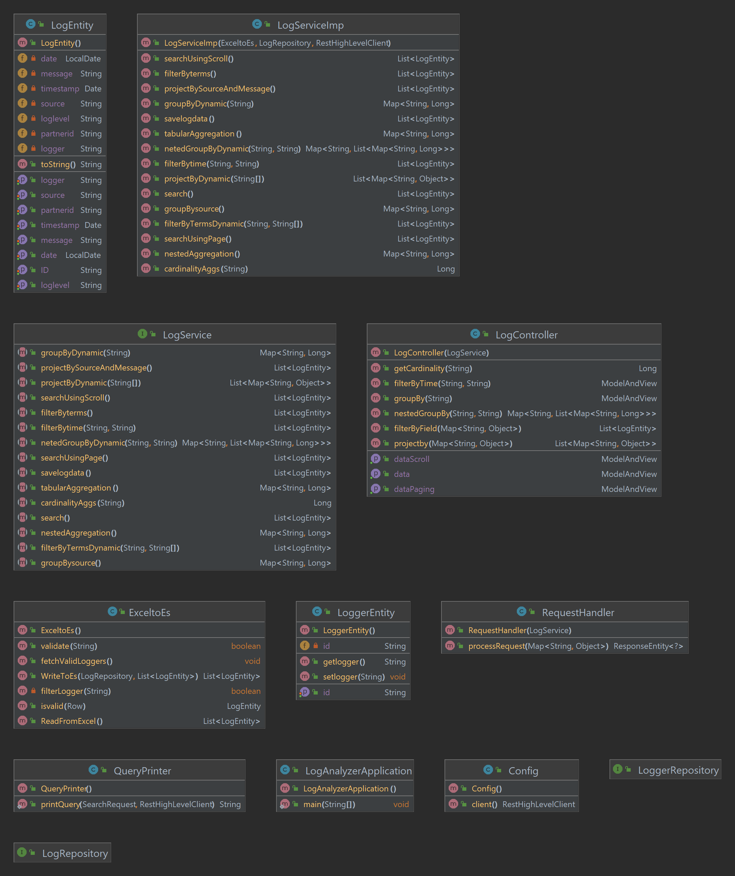
Structure
Class Diagram
© 2023 Sprinklr, Inc. CONFIDENTIAL - INTERNAL ONLY. All rights reserved.

Slide 12
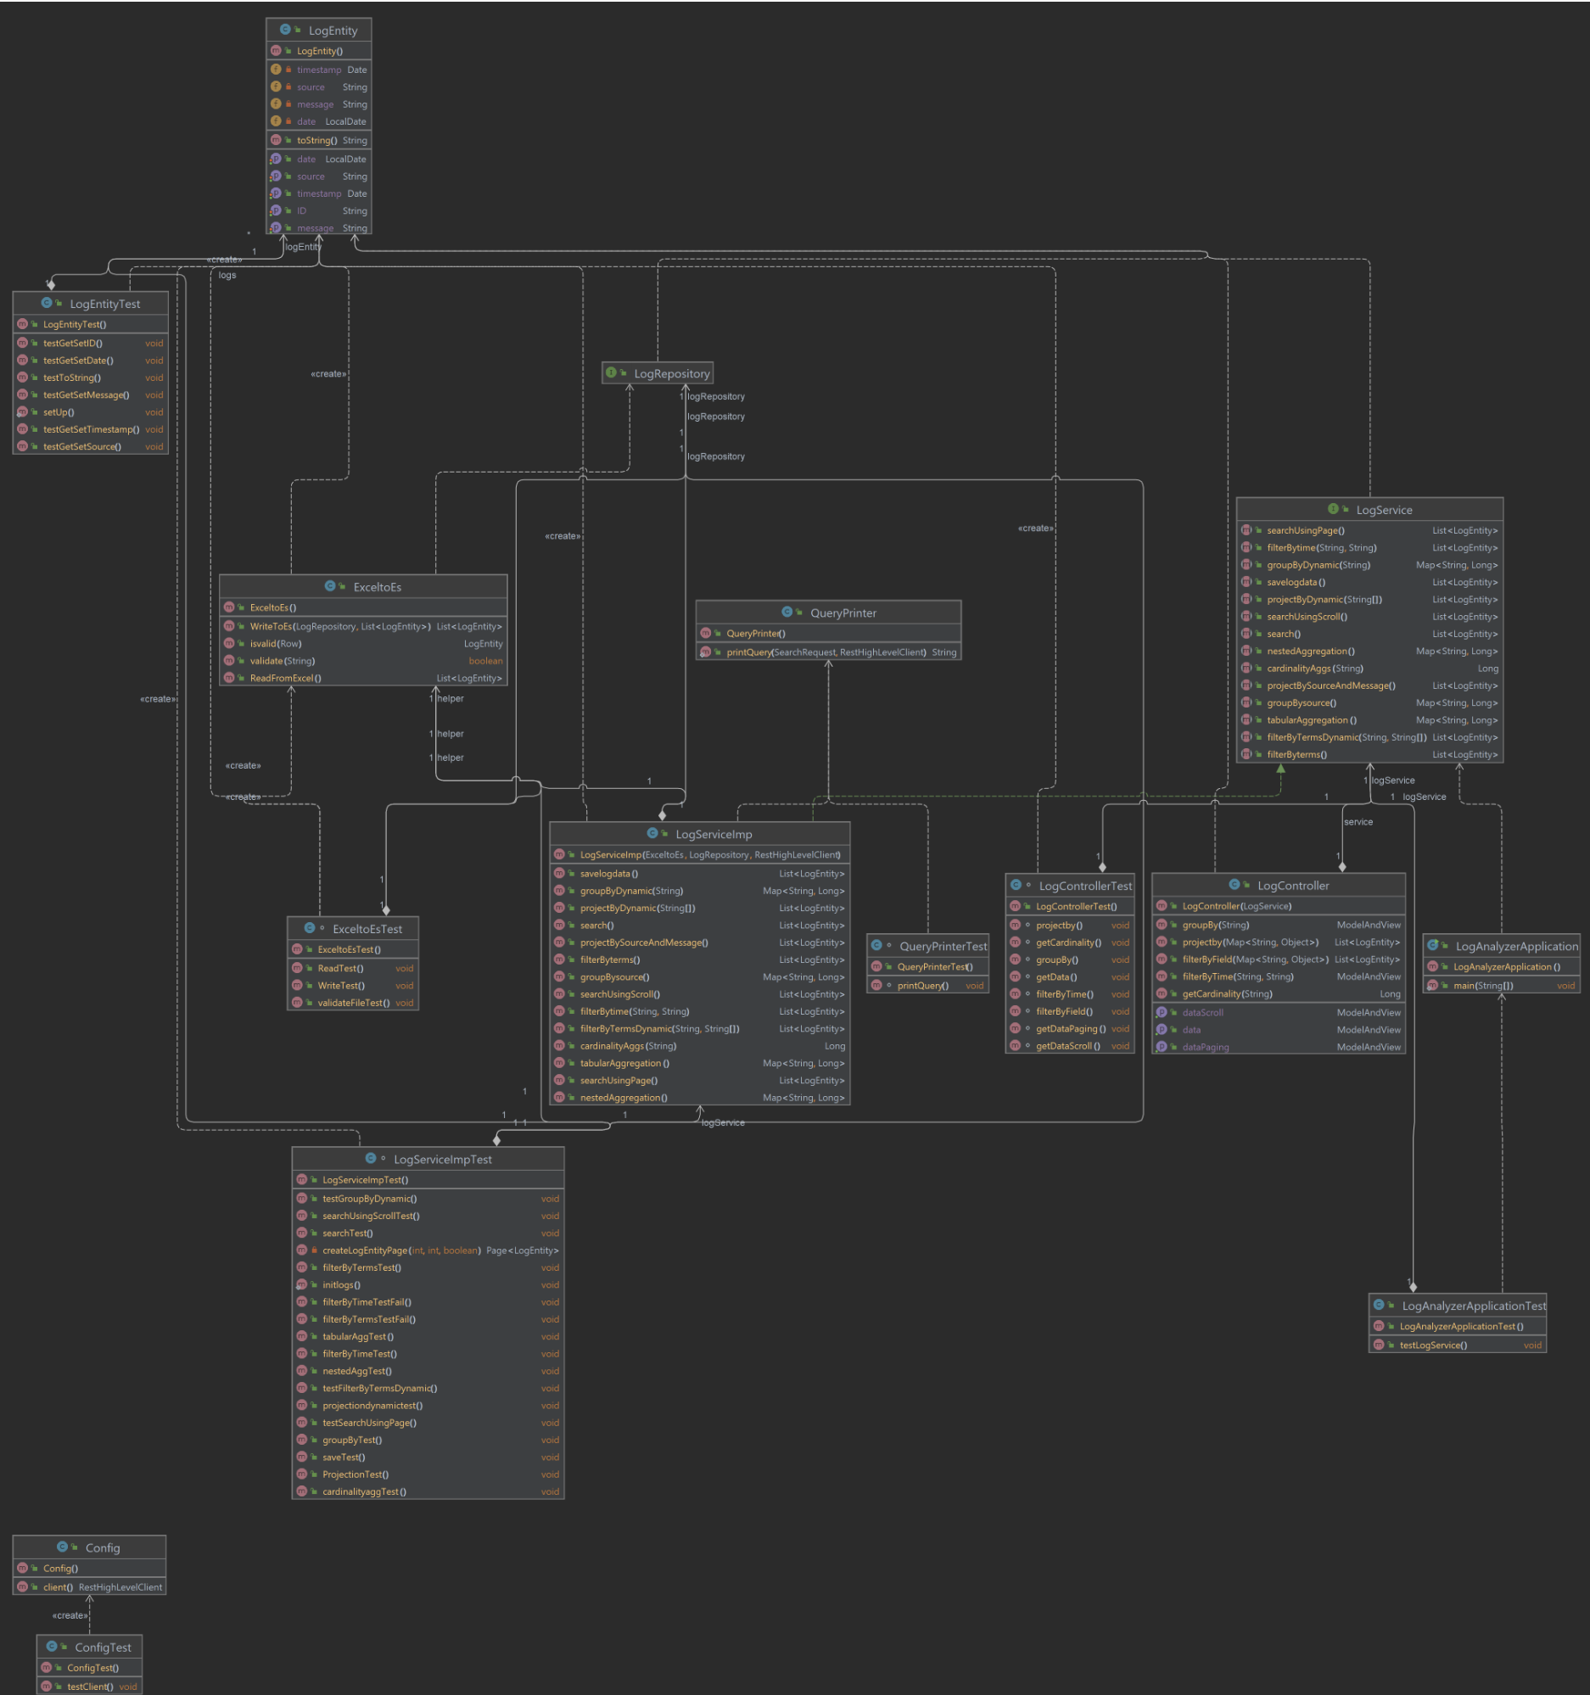
Structure
Class dependency diagram
© 2023 Sprinklr, Inc. CONFIDENTIAL - INTERNAL ONLY. All rights reserved.

Slide 13
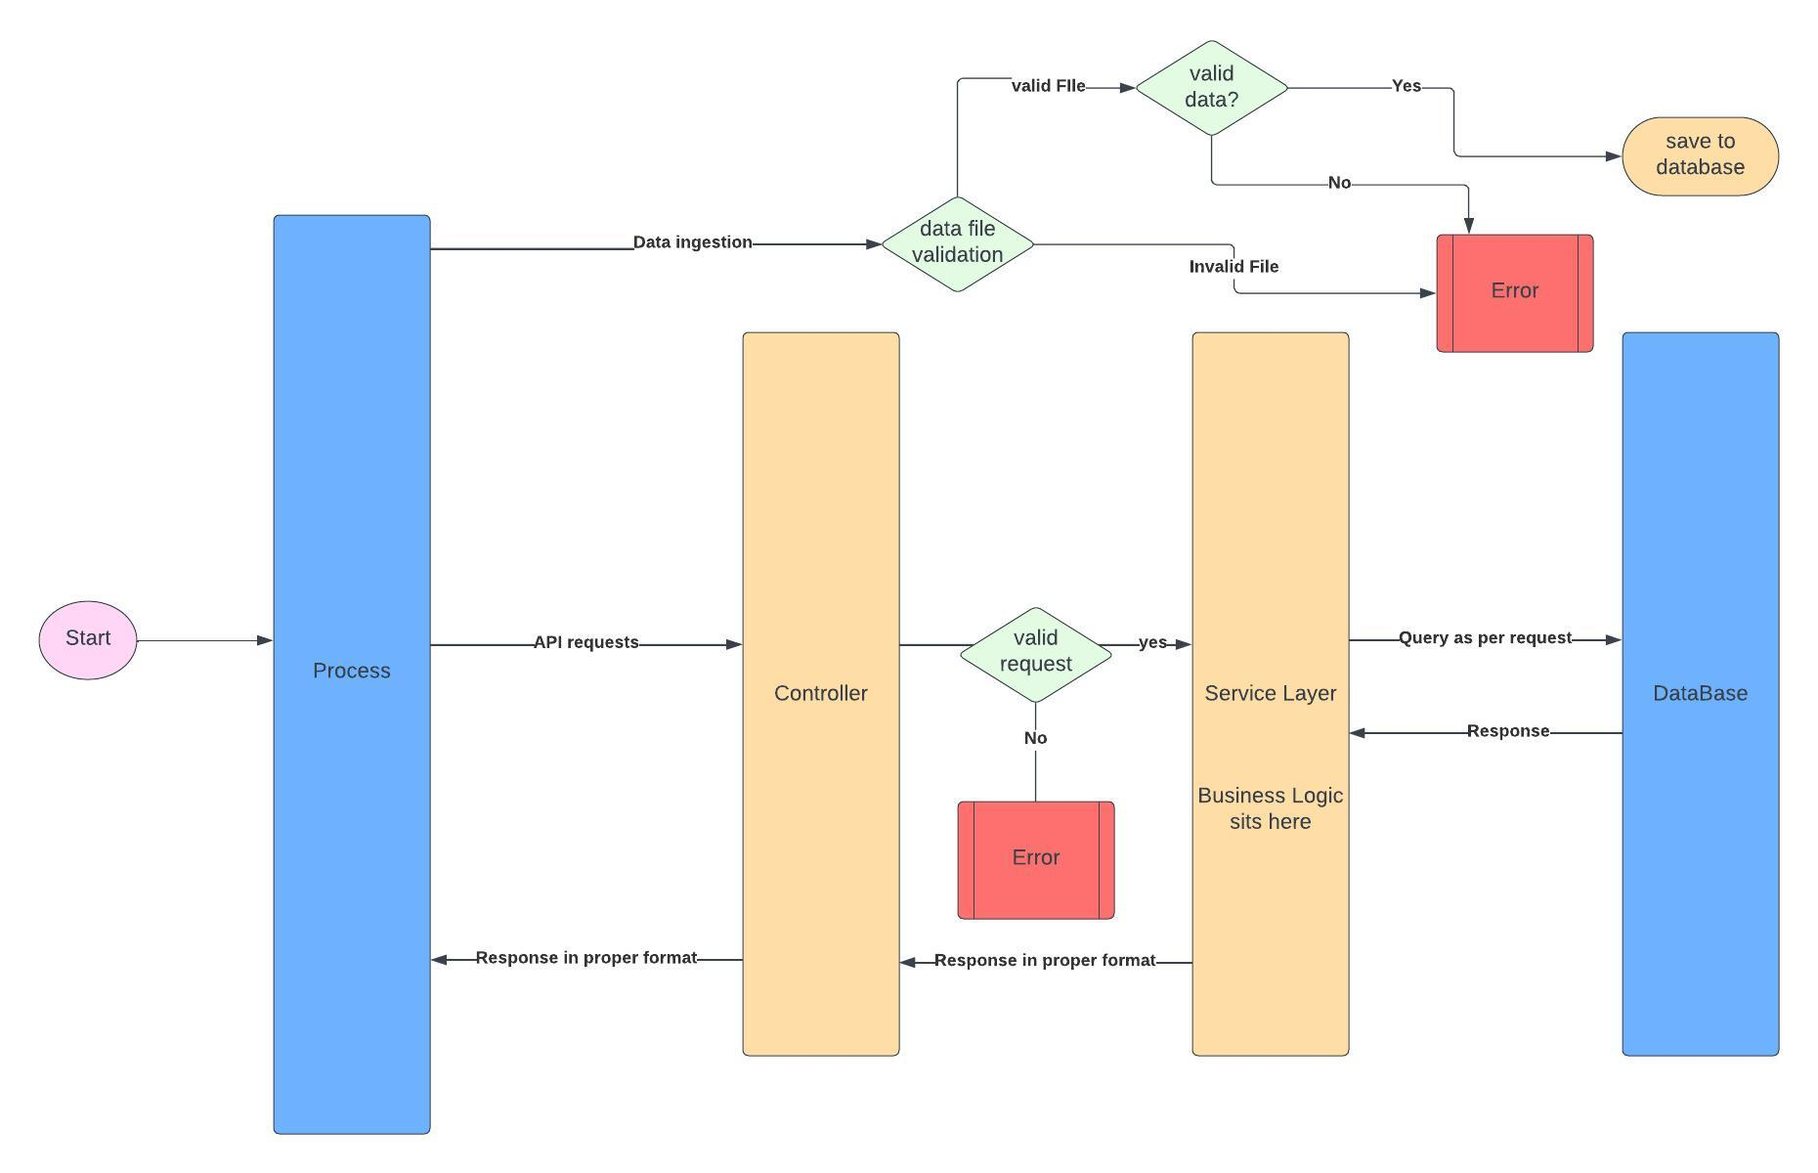
Structure
Activity Diagram
© 2023 Sprinklr, Inc. CONFIDENTIAL - INTERNAL ONLY. All rights reserved.

Slide 14
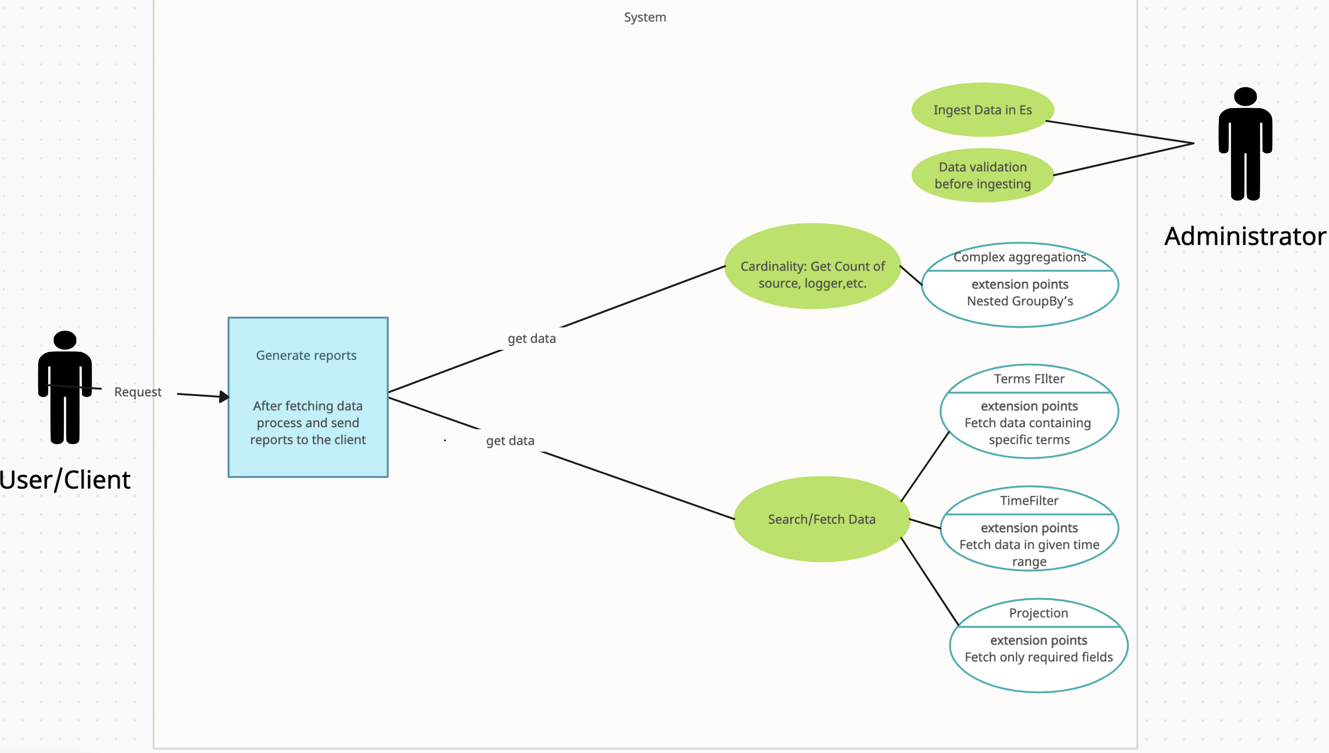
Use Cases
Use Case Diagram
© 2023 Sprinklr, Inc. CONFIDENTIAL - INTERNAL ONLY. All rights reserved.

Slide 15
Usability of the Project
Efficient Data ingestion. The project provides various validation on the data field and also filters the data based on certain fields such as Logger and the Log Level.
As the main goal of the project was to fetch data efficiently and then generate reports on the fetched data. The project has exposed APIs which supports data fetching through all the basic and intuitive techniques such as groupBys, projection, Time and terms filtering, and other complex aggregations.
Advantages of our Application over Kibana
Kibana does not provide any validation and filter over data before ingesting
We can write custom queries based on our use case to generate reports. For example on a particular date how many exceptions are caused for a particular logger.
We can fetch data from by hitting endpoints of this application and view it in any form
as the client desires.
The application itself provides reports in form of tables in some search cases.
Client does not have to think and write query himself in the Kibana console to fetch data
© 2023 Sprinklr, Inc. CONFIDENTIAL - INTERNAL ONLY. All rights reserved.

Slide 16
More advantages
Customization: With custom queries, We can filter and aggregate the data in specific ways that are tailored to Our business needs.
Scalability. As the volume of log data increases, a custom service can be optimized to handle the increased load more effectively.
Automation: We can automate many tasks, such as alerting and archiving. Through this application
Security: We can restrict access to certain data sets or limit the actions that users can perform on the data.
Integration: can be integrated more easily with other systems and tools
© 2023 Sprinklr, Inc. CONFIDENTIAL - INTERNAL ONLY. All rights reserved.

Slide 17
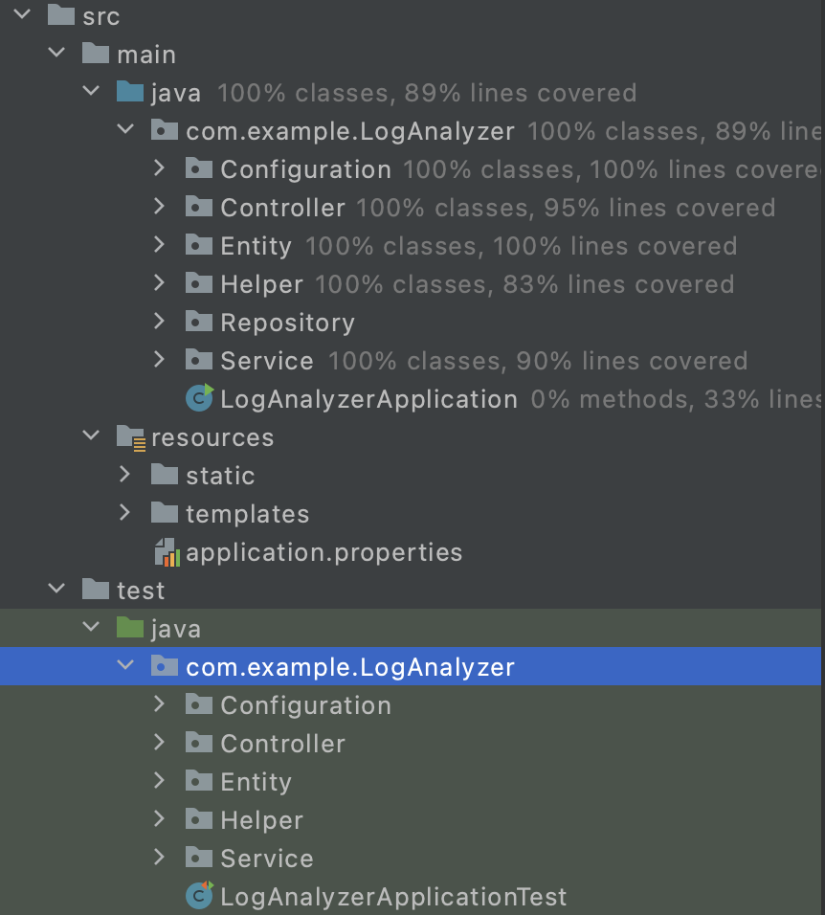
Structure
Source directory structure
© 2023 Sprinklr, Inc. CONFIDENTIAL - INTERNAL ONLY. All rights reserved.

Slide 18
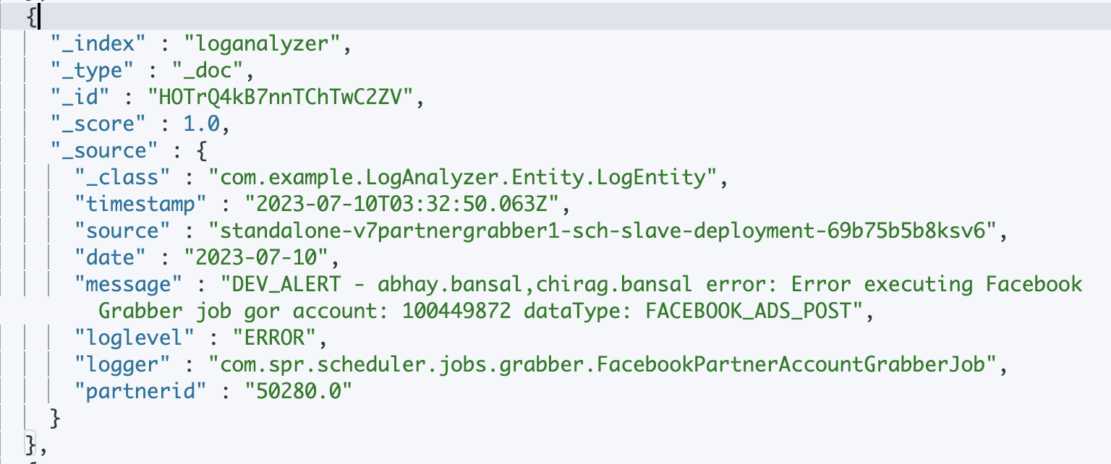
Structure
Document Structure
© 2023 Sprinklr, Inc. CONFIDENTIAL - INTERNAL ONLY. All rights reserved.

Slide 19
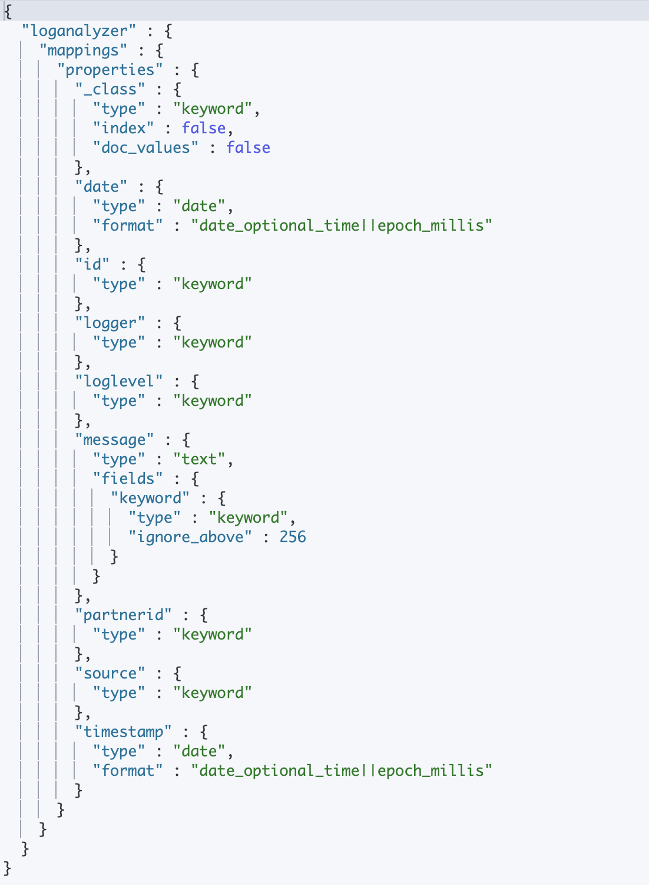
Structure
Index Mapping
© 2023 Sprinklr, Inc. CONFIDENTIAL - INTERNAL ONLY. All rights reserved.

Slide 20
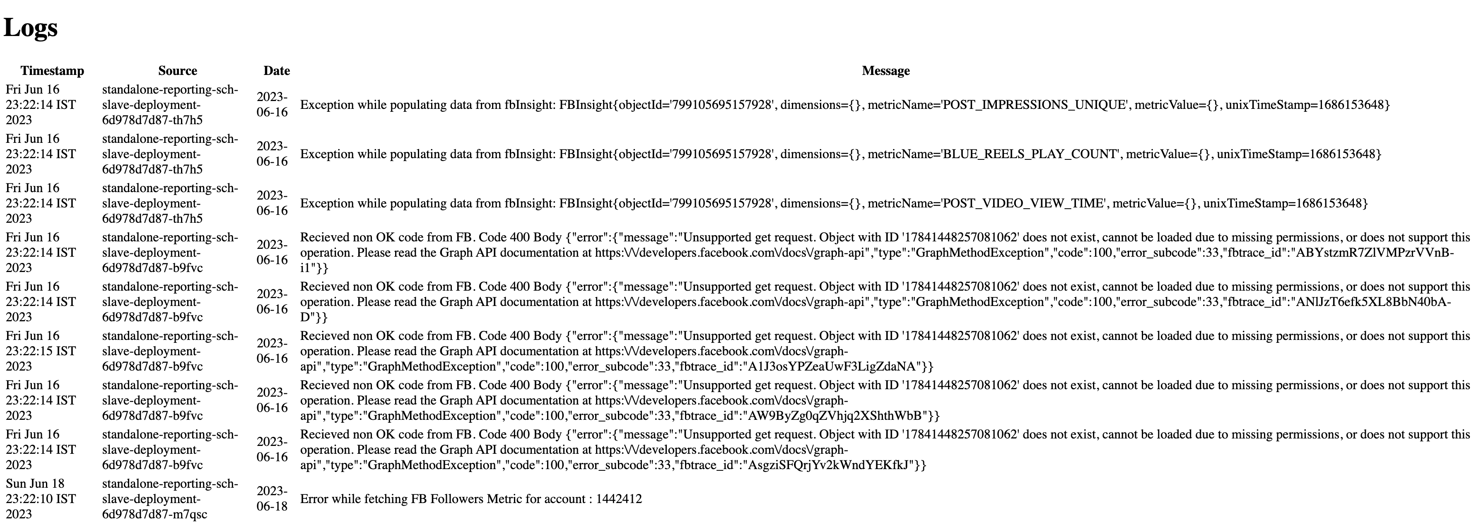
Results
Search results
© 2023 Sprinklr, Inc. CONFIDENTIAL - INTERNAL ONLY. All rights reserved.

Slide 21
Results
Search results using paging
© 2023 Sprinklr, Inc. CONFIDENTIAL - INTERNAL ONLY. All rights reserved.

Slide 22
Results
Search results using scroll
© 2023 Sprinklr, Inc. CONFIDENTIAL - INTERNAL ONLY. All rights reserved.

Slide 23
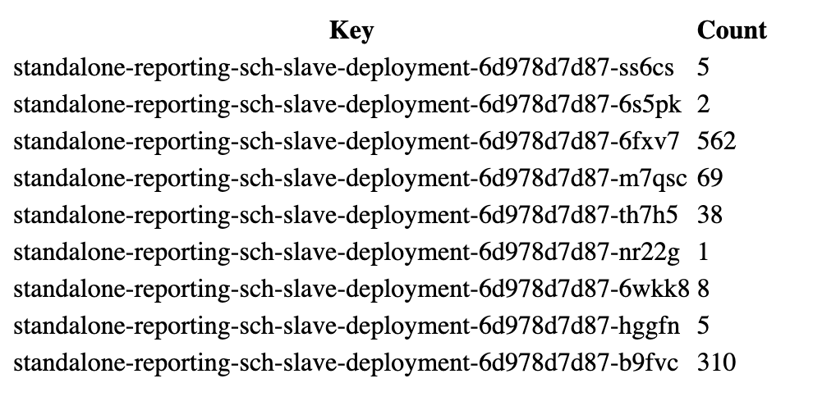
Results
GroupBy source
© 2023 Sprinklr, Inc. CONFIDENTIAL - INTERNAL ONLY. All rights reserved.

Slide 24
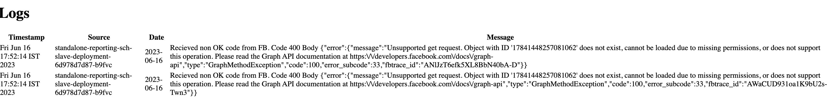
Results
Filter by time
© 2023 Sprinklr, Inc. CONFIDENTIAL - INTERNAL ONLY. All rights reserved.

Slide 25
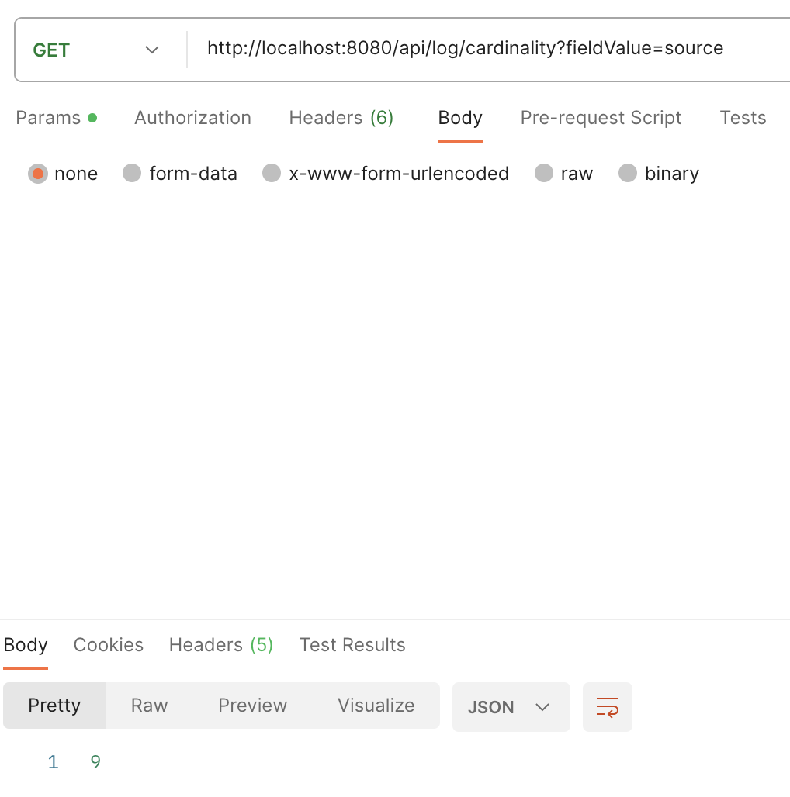
Results
Get cardinality
© 2023 Sprinklr, Inc. CONFIDENTIAL - INTERNAL ONLY. All rights reserved.

Slide 26
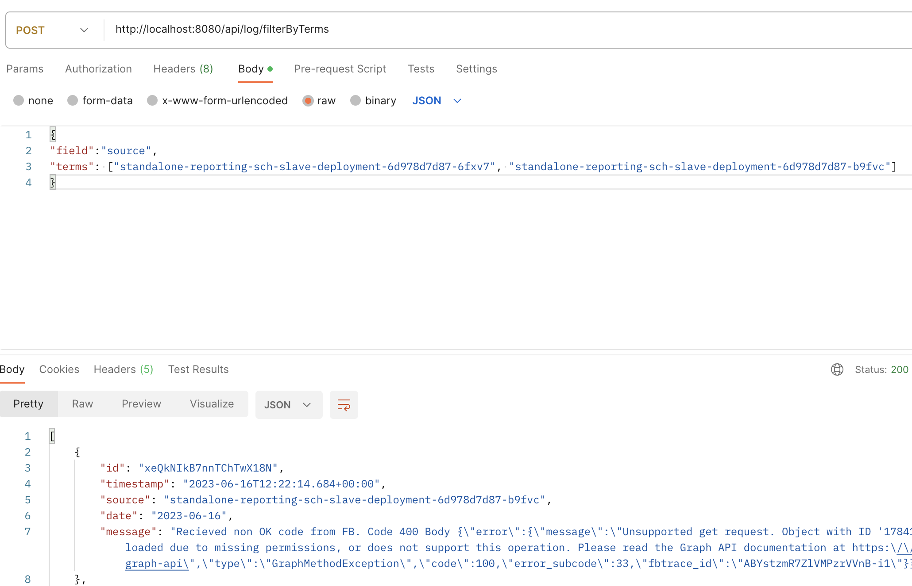
Results
Filter data by terms
© 2023 Sprinklr, Inc. CONFIDENTIAL - INTERNAL ONLY. All rights reserved.

Slide 27
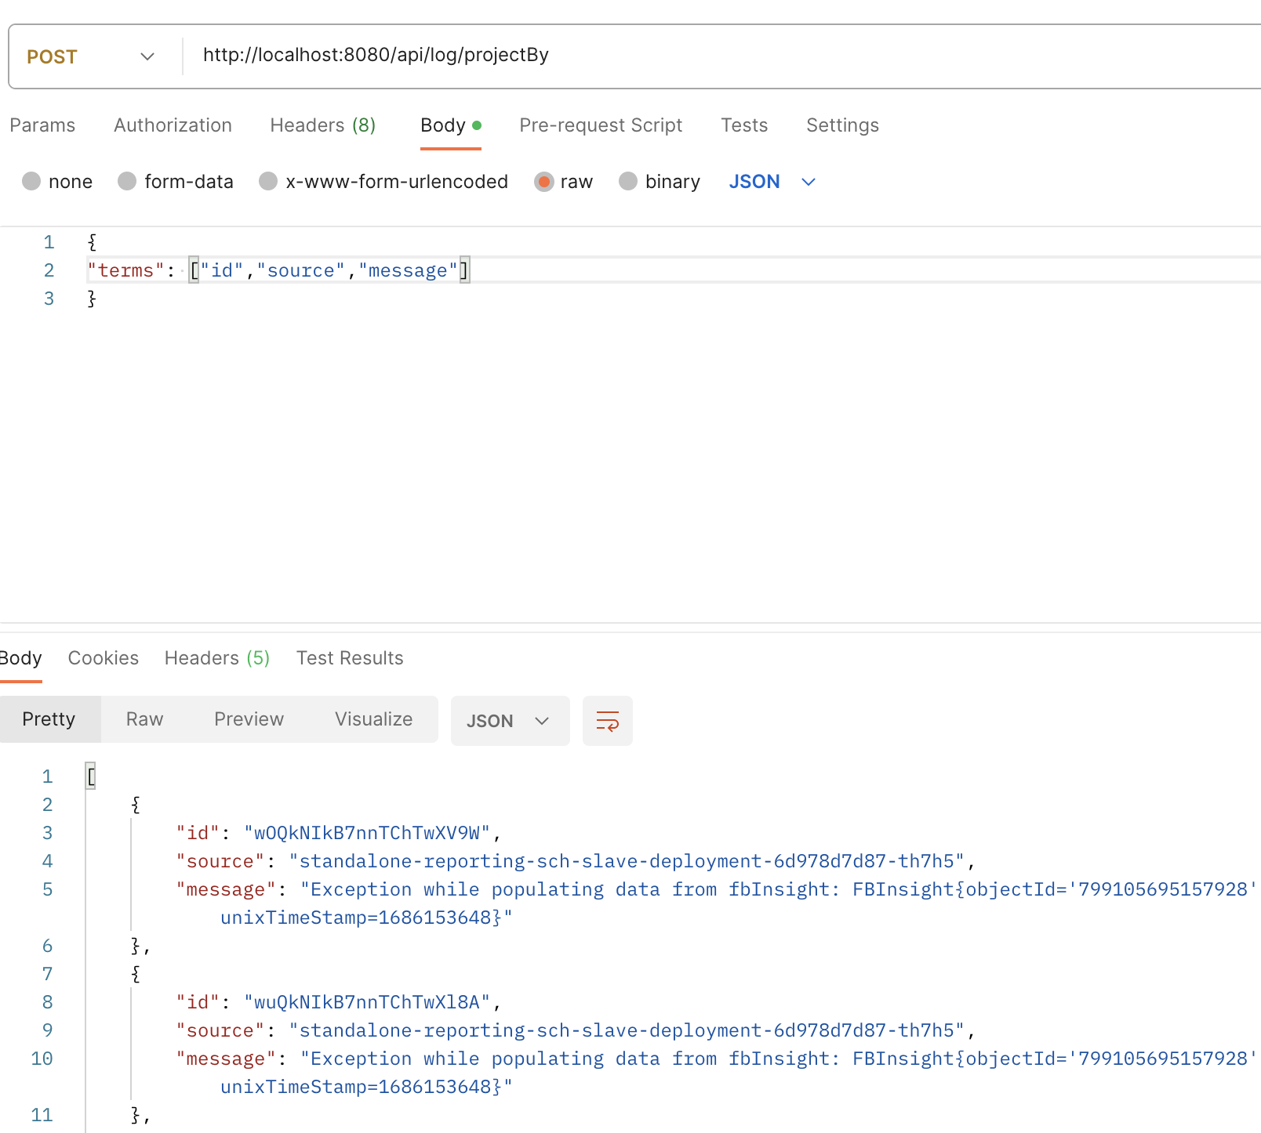
Results
Project only certain fields
© 2023 Sprinklr, Inc. CONFIDENTIAL - INTERNAL ONLY. All rights reserved.

Slide 28
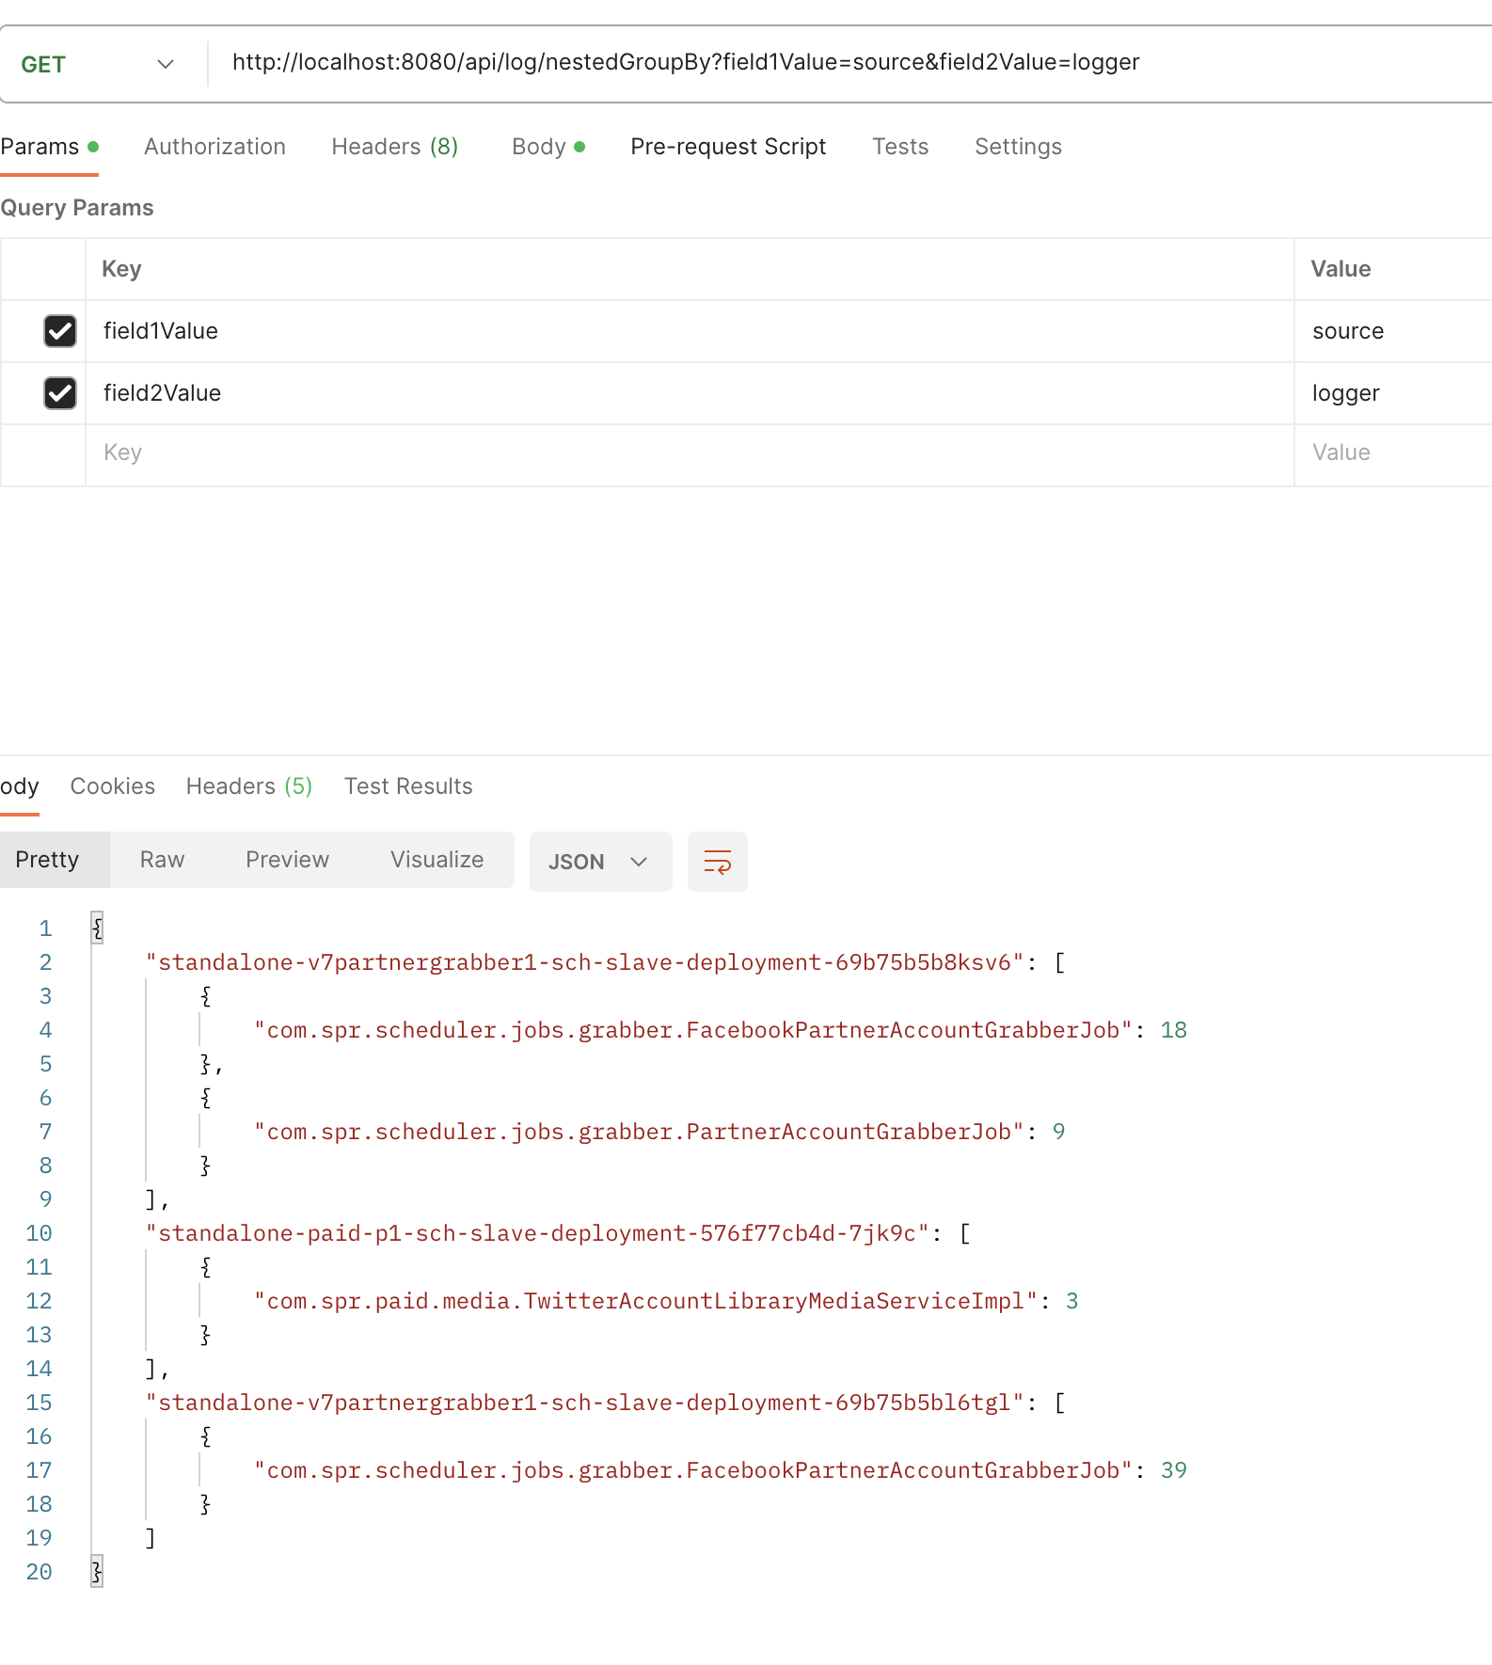
Results
Nested GroupBy
© 2023 Sprinklr, Inc. CONFIDENTIAL - INTERNAL ONLY. All rights reserved.

Slide 29
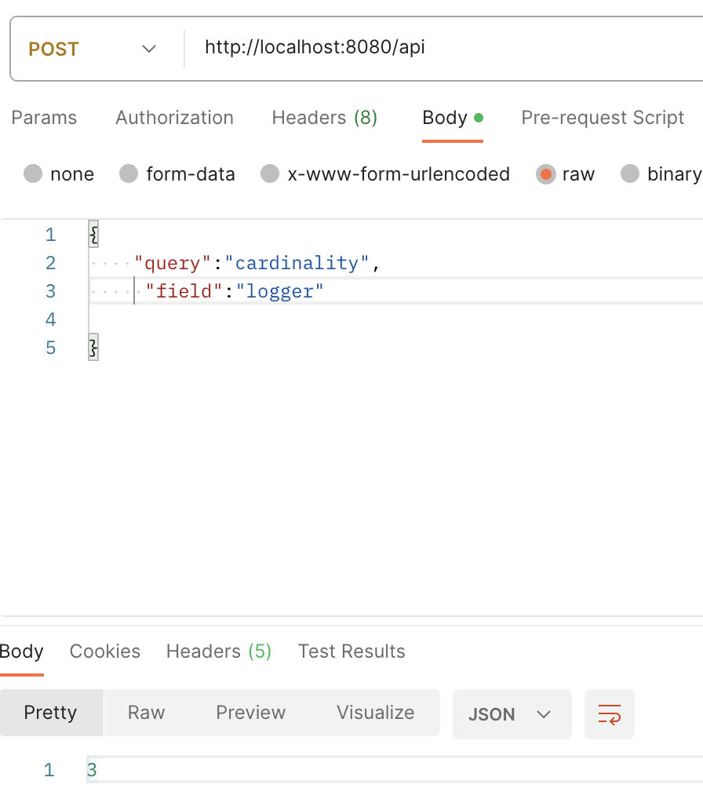
Results
General API:
Cardinality request
© 2023 Sprinklr, Inc. CONFIDENTIAL - INTERNAL ONLY. All rights reserved.

Slide 30
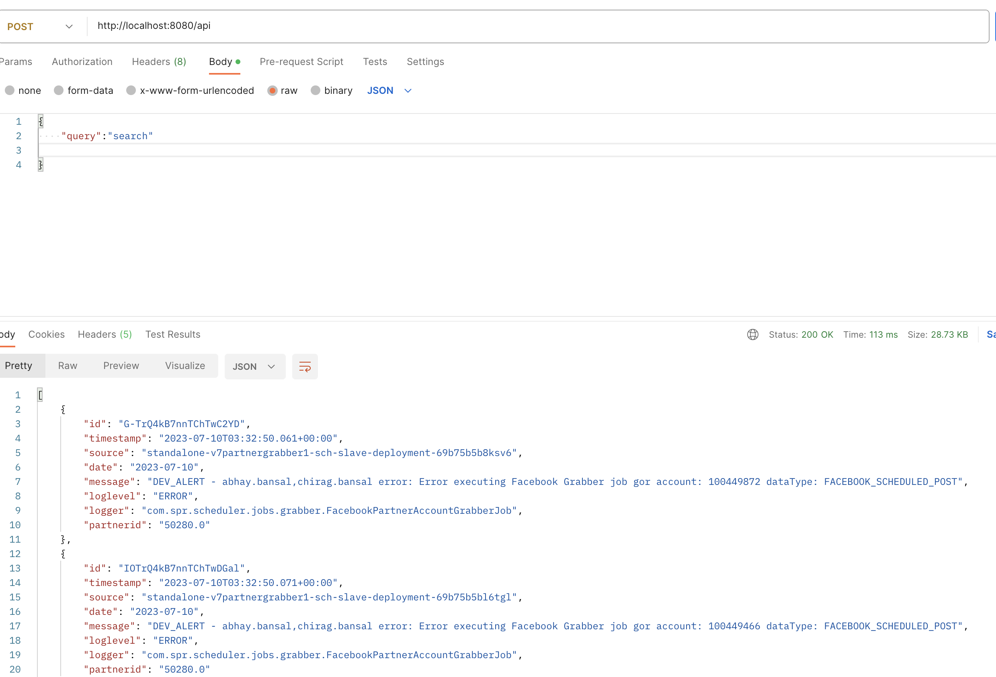
Results
General API:
Search request
© 2023 Sprinklr, Inc. CONFIDENTIAL - INTERNAL ONLY. All rights reserved.

Slide 31
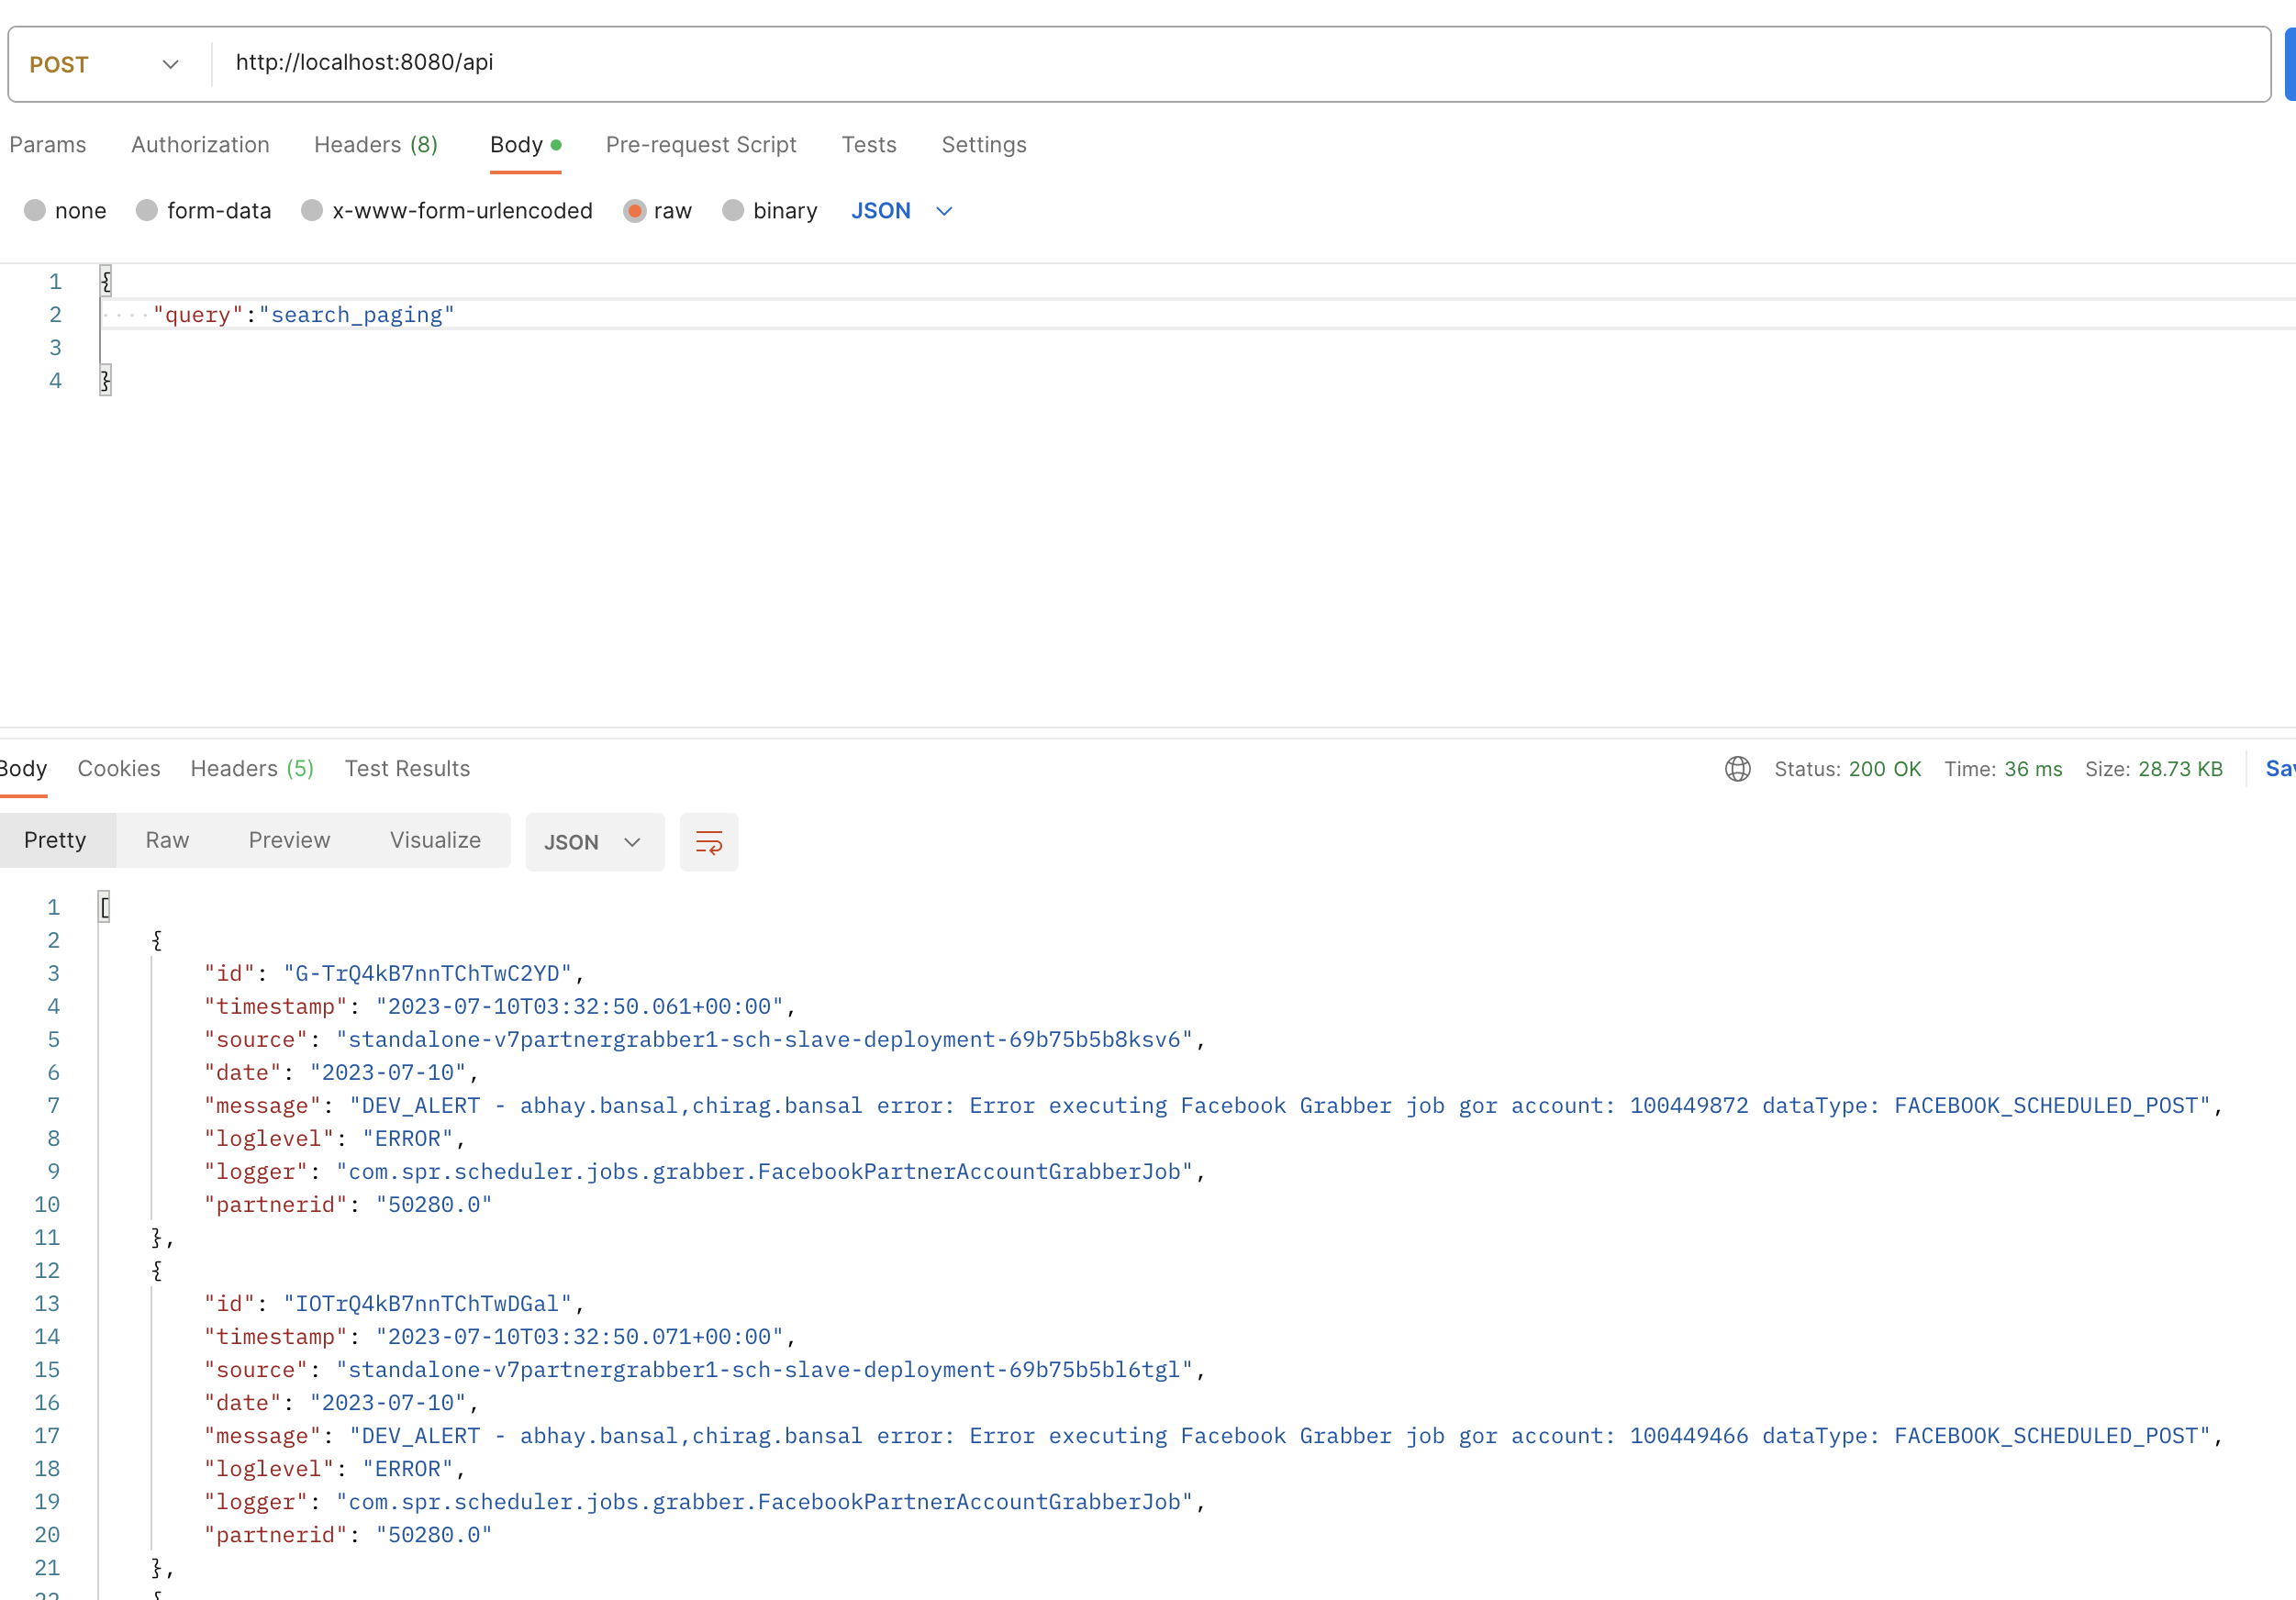
Results
General API:
Search using paging
© 2023 Sprinklr, Inc. CONFIDENTIAL - INTERNAL ONLY. All rights reserved.

Slide 32
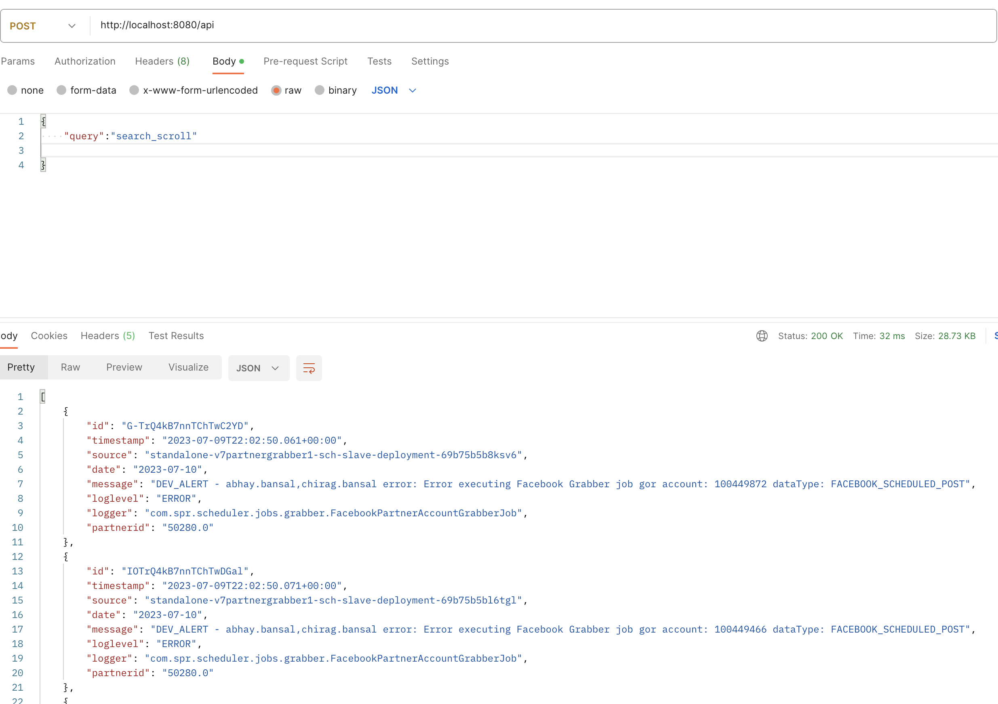
Results
General API:
Search using scroll
© 2023 Sprinklr, Inc. CONFIDENTIAL - INTERNAL ONLY. All rights reserved.

Slide 33
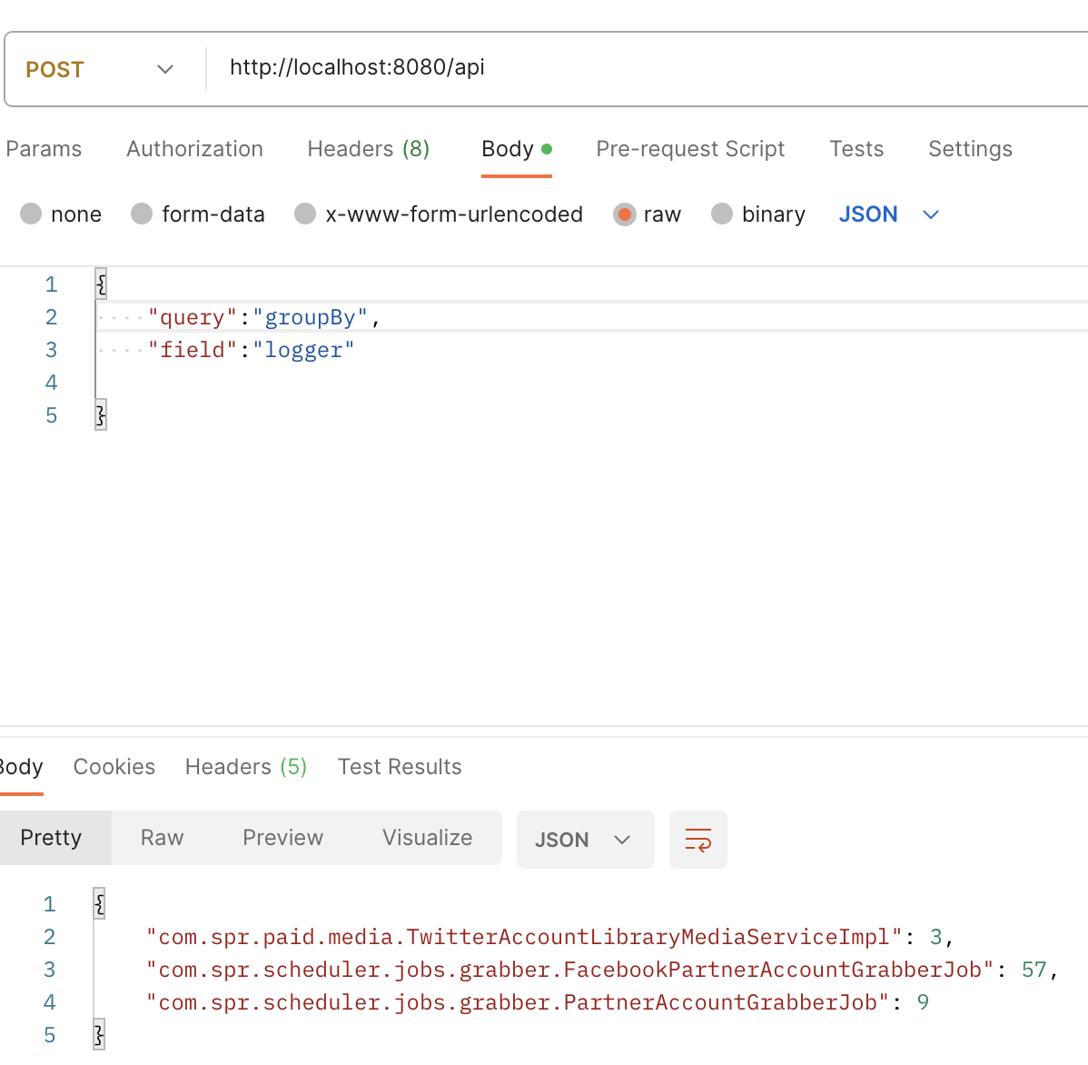
Results
General API:
GroupBY
© 2023 Sprinklr, Inc. CONFIDENTIAL - INTERNAL ONLY. All rights reserved.

Slide 34
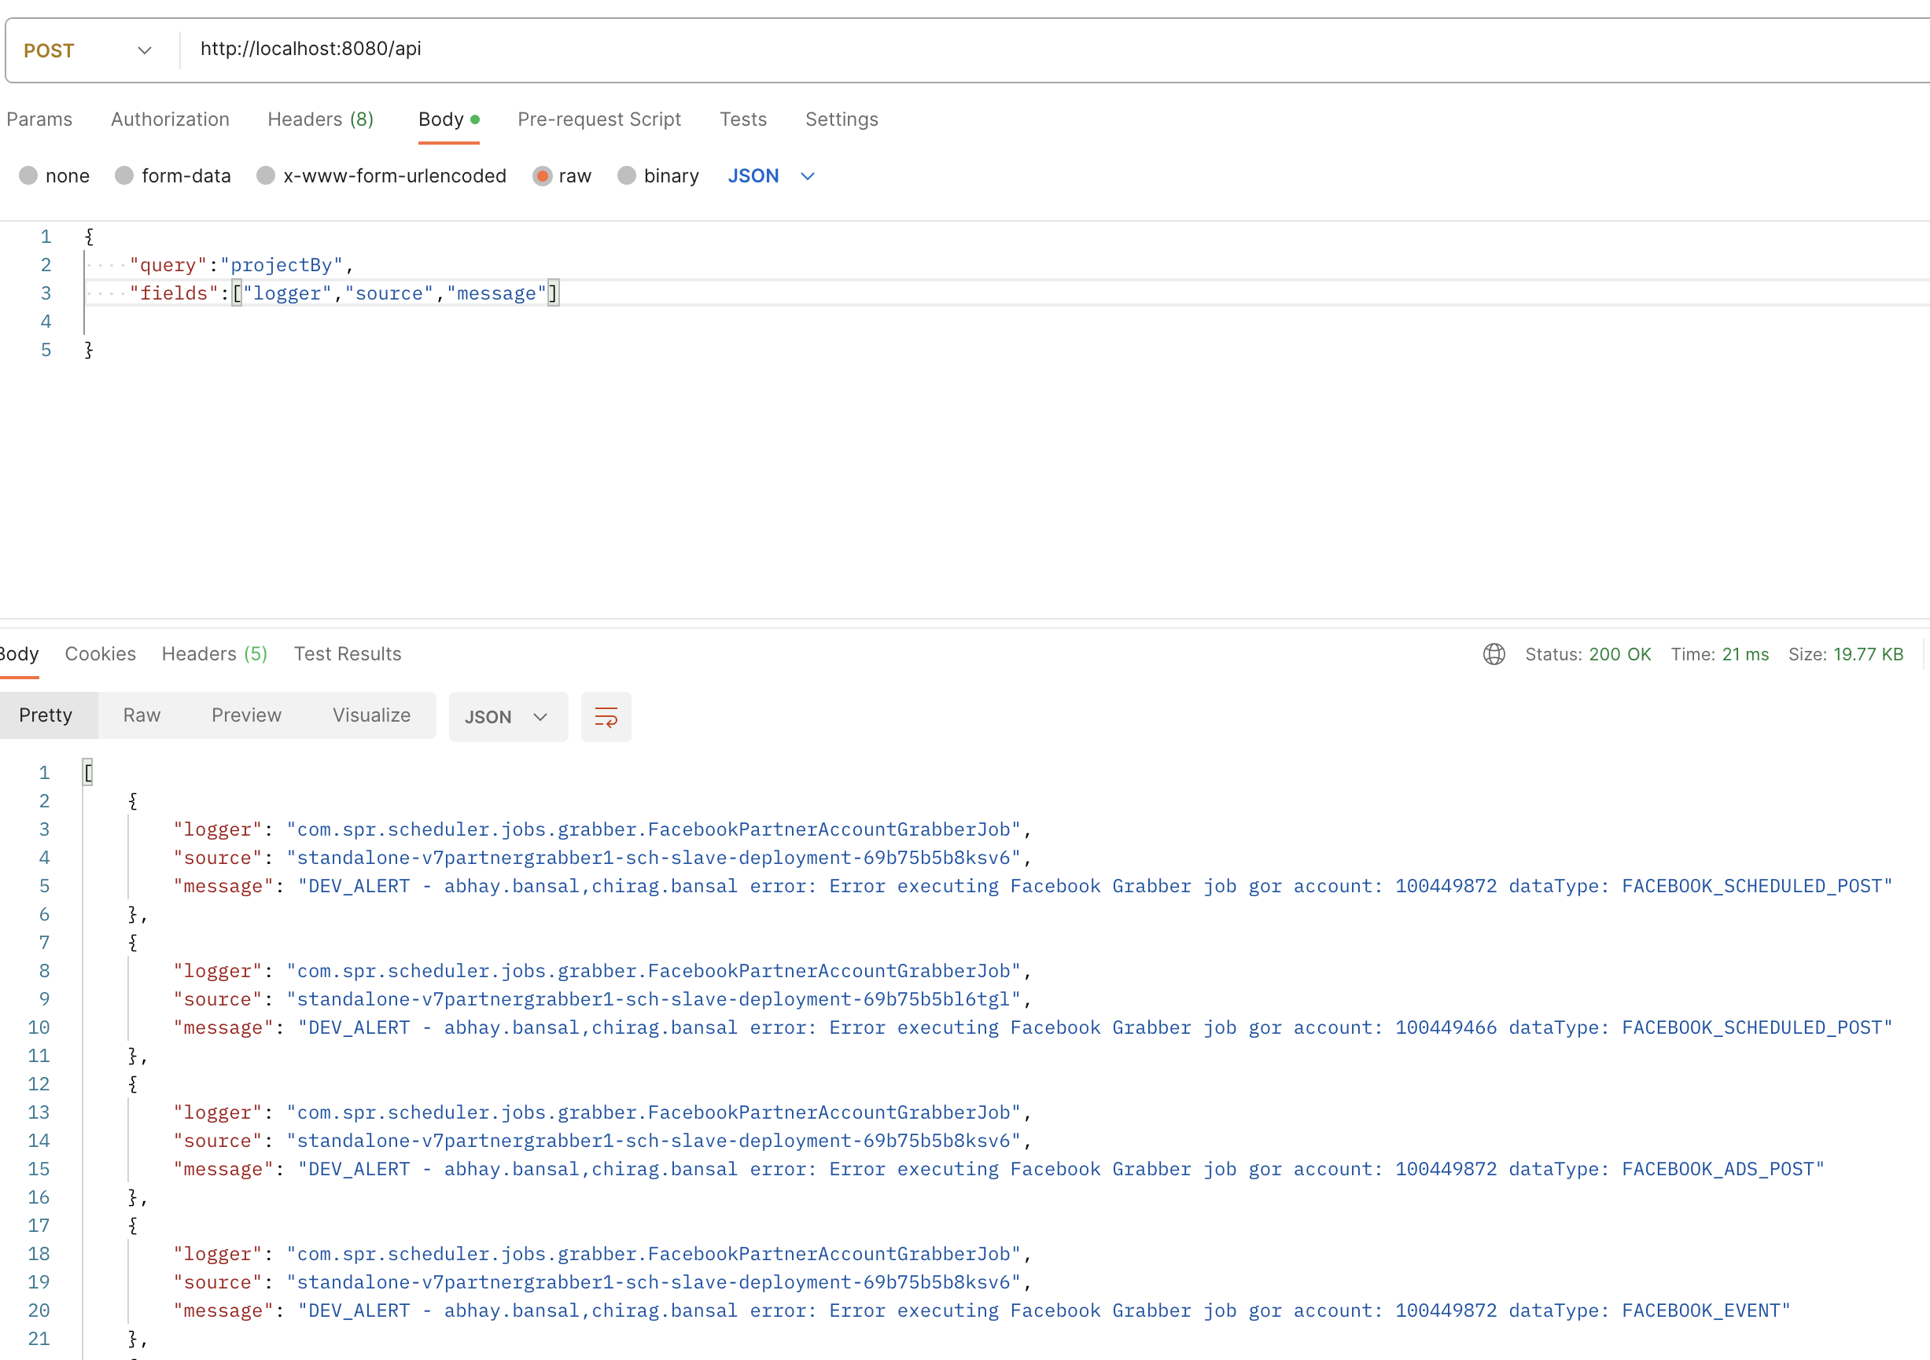
Results
General API:
ProjectBy
© 2023 Sprinklr, Inc. CONFIDENTIAL - INTERNAL ONLY. All rights reserved.

Slide 35
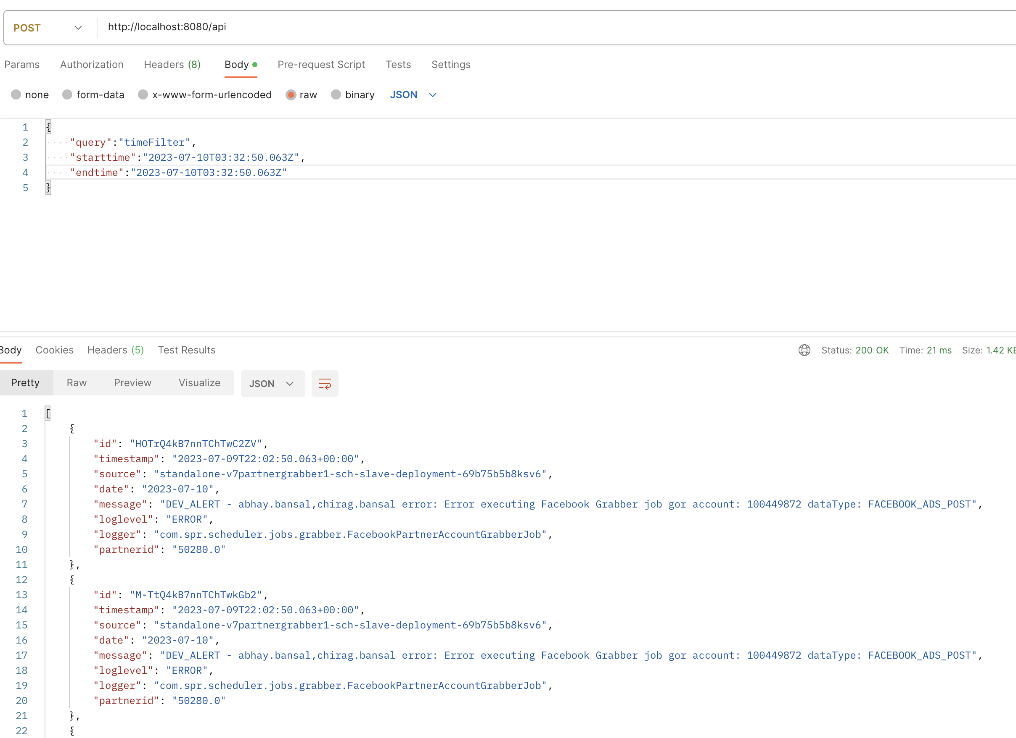
Results
General API:
time filter
© 2023 Sprinklr, Inc. CONFIDENTIAL - INTERNAL ONLY. All rights reserved.

Slide 36
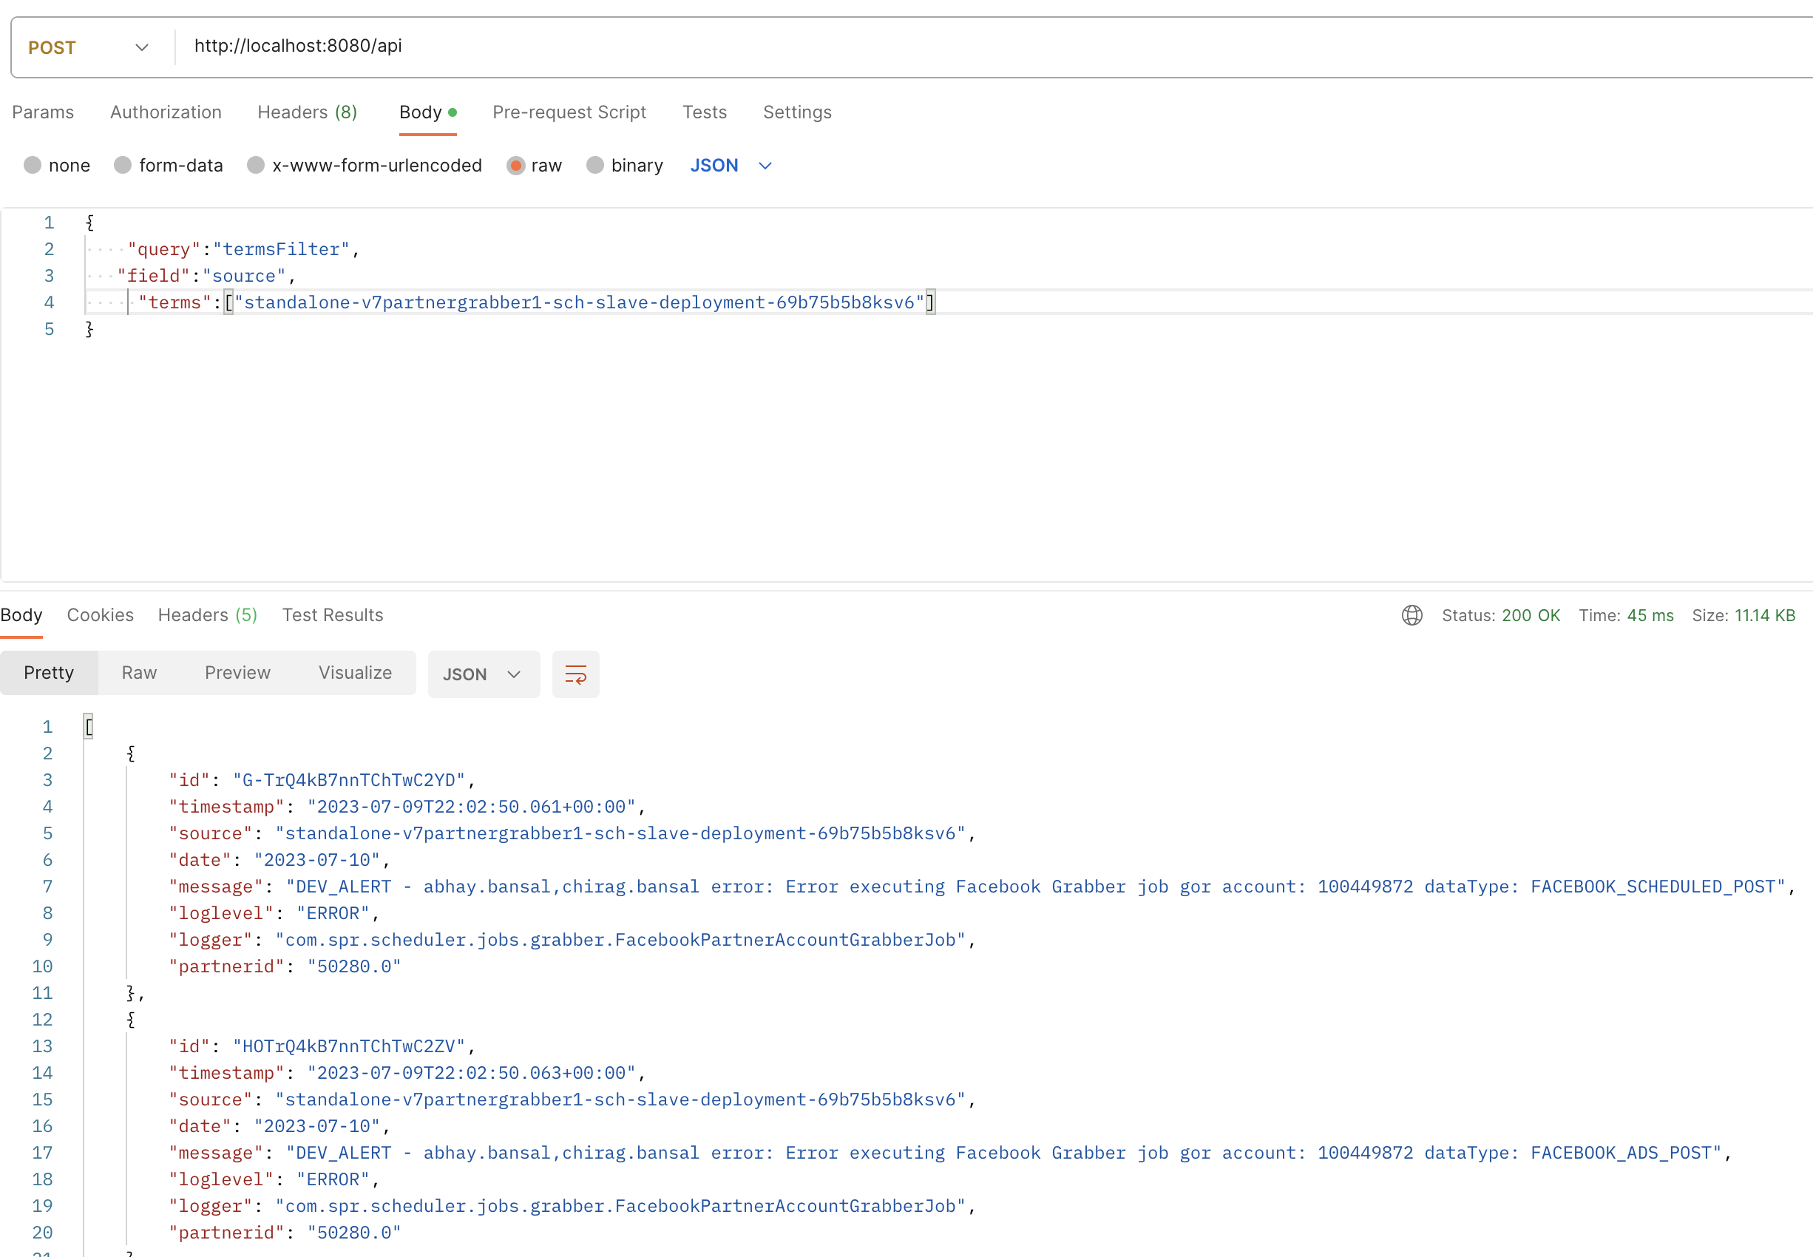
Results
General API:
Terms filter
© 2023 Sprinklr, Inc. CONFIDENTIAL - INTERNAL ONLY. All rights reserved.

Slide 37
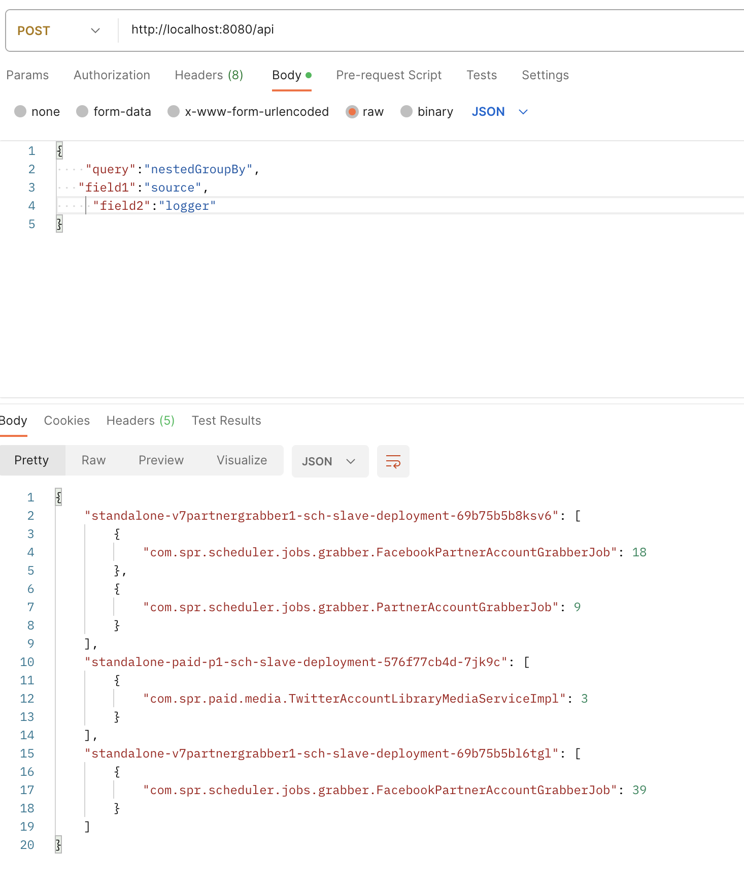
Results
General API:
Nested GroupBy
© 2023 Sprinklr, Inc. CONFIDENTIAL - INTERNAL ONLY. All rights reserved.

Slide 38






Learnings
Spring Boot
Got to learn Spring Boot. Dependency Injection, Inversion of control, how to handle beans. It makes easier to test, deploy and manage applications.
ElasticSearch and Kibana.
How the data is stored as documents and how the documents are indexed. Tried various queries on the sample data provided by ElasticSearch. Completed the ElasticSearch course available on official ElasticSearch youtube channel.
Mongodb
Worked with Mongodb Atlas Completed the course available on their official site
Junit
Learned unit testing and used various tools such as Mockito and Mockmvc to test the code efficiently. Also worked with test suites.
.
© 2023 Sprinklr, Inc. CONFIDENTIAL - INTERNAL ONLY. All rights reserved.

Slide 39
Learnings
Learned more about GitHub. How to work on shared repo, how to apply branch protection rules, how to delete past commits.
Learned about how to use thymeleaf templates so that we can visualize the data fetched by the server without any 3rd party client, i.e Server side rendering.
Few other things: Intellij debugger, gradle, java web services, SOLID design principles, java memory management, read java head first book.
© 2023 Sprinklr, Inc. CONFIDENTIAL - INTERNAL ONLY. All rights reserved.

Slide 40

Tech Stack
Spring Boot, Java, ElasticSearch, MongoDB, Thymeleaf, Junit

Slide 41
Thank you
shyam.prajapati@sprinklr.com
sprinklr.com

